Slide 1


Project Presentation (KCS 753) SMART CARE Project Id- PCS-23-07
KIET Group of Institutions, Ghaziabad
(An ISO – 9001: 2008 Certified & ‘A+’ Grade accredited Institution by NAAC)
Mentor- Dr Harsh Khatter
Team Members-
Hanu Agarwal (2000290120067-A)
Chhayank Tyagi (2000290120059-A)
Khushi (2100290129005-C)

Slide 2

Problem Statement
Many of the hospital have healthcare solutions for the document and patient record purposes.
But Patient don’t have the access to see all the details and medical history.
There are various common cases for patients like:
Patients generally refer multiple doctors and clinics for the treatment of the disease
Some of the times, patient face challenges in maintaining reports of tests and doctor prescription i.e. paper-based health records and their prescriptions.
Patients are unable to tell the exact health issues and what had happened previously, where the doctor need to know about the previous treatments and what is the history of the patient. This helps the doctor to take references from it and give the much effective treatment.

Slide 3
Objectives
To Combine technology and digital tools to improve Health care system and make it Smart i.e. SMART CARE
Increase the efficiency of healthcare delivery and treatment by the doctors
Patients can have their documents in well-structured form.
Doctor can also maintain the records of their patients and can see their reports and prescription through the patient id generated by software if patients want to show.
The main objective of this project is, patient can tell current doctor about their previous medical history and can show medical reports and prescription by previous doctor.
Where the previous doctors technical remarks and the severity of disease can help the current doctor in treatment.

Slide 4
Technology Used
Front end
HTML
CSS
JAVASCRIPT
Backend
Spring Boot
MYSQL

Slide 5
Literature Survey
To work on the project, various research papers are studied which have idea about the health care systems and how they work.
Various hospital systems of India and Aboard, are also seen to know the available features and what services they are providing to the doctors and the patients.
The thing is to make the system more reliable, transparent, secure and user friendly.

Slide 6
Survey Paper 1
Paper Title: SmartCare: An Introduction
Author Name: Michael Smith
Summary:
Smart Care is a project aimed at creating a smart environment for aging in place, based on a retirement community apartment. The system uses unobtrusive sensing technologies to enable non-intrusive at-home monitoring, diagnostic support, and self-management in complex treatment plans.
The prototype has been deployed in an independent living apartment at Lakewood Village Senior Living Community, allowing testing and evaluation of the technologies in a real elder care environment.
The SmartCare project consists of three main data layers: data layer, analysis layer, and interface layer. The visualization module(VISMA) allows for real-time visualization of the current state of the apartment or revisualization of the past data for later analysis.

Slide 7
Survey Paper 2
Paper Title: Designing Interactive Health Care Systems: Bridging the Gap Between Patients and Health Care Professionals
Author Name: Mohammad Moshirpour
Summary:
This research paper give knowledge about the patient-healthcare professional relationship is evolving as patients become more proactive about their health and turn to technologies like the Internet for knowledge acquisition.
This study examines the high-level design of a perceived medical system and the implications of adding patients as active contributors. The main challenge of modifying existing systems to incorporate patient interaction is preserving system integrity.
A systematic approach is proposed to support scaling health care systems while preserving system integrity. Distributed systems like personal health records and eHealth systems provide two ways for patients to become more involved with their own health care.
One is the lack central control in distributed systems which adds complexity to health systems, posing challenges for design and modification.
Secondly the use of the emergent behaviour detection (EBD) tool which offers potential cost savings by proactively identifying behaviours during the design phase.

Slide 8
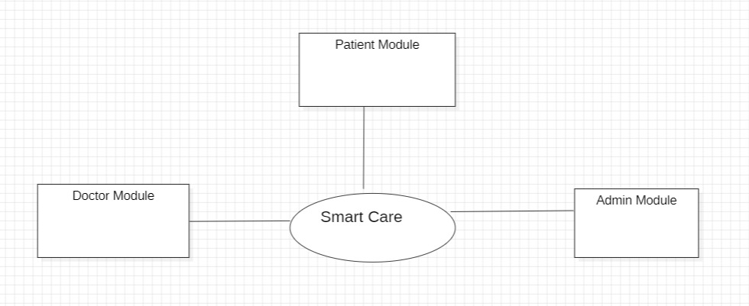
Workflow Diagram: DFD Level 0
Three main modules:
Doctor
Patient
Admin

Slide 9
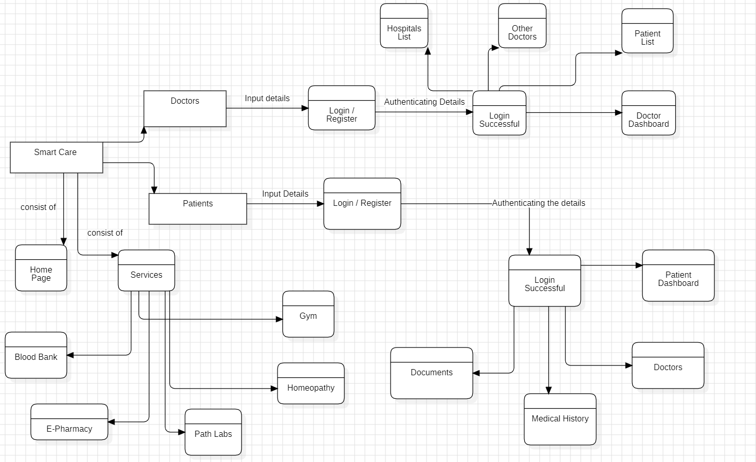
Work Flow: DFD Level 1

Slide 10
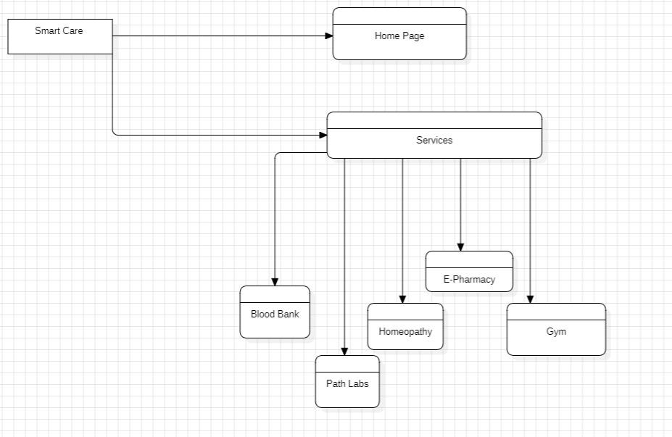
Work Flow: DFD Level 2

Slide 11
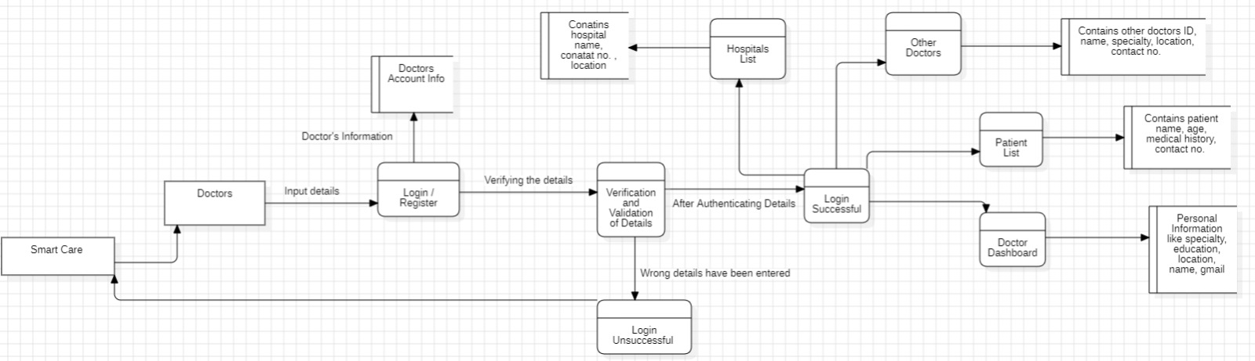
Work Flow: DFD Level 2 (Doctors)

Slide 12
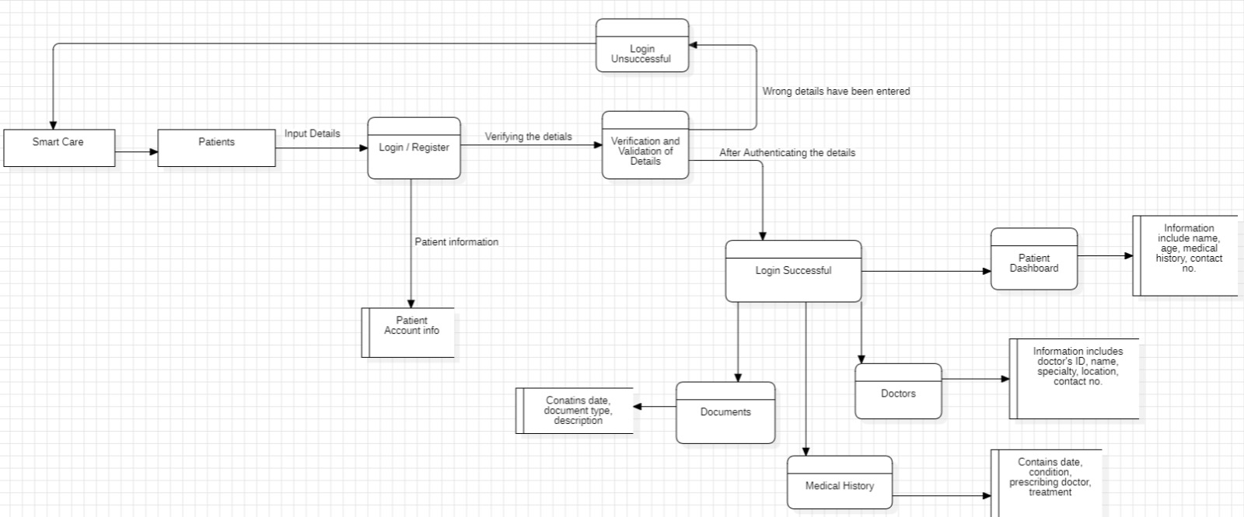
Work Flow: DFD Level 2 (Patient)

Slide 13
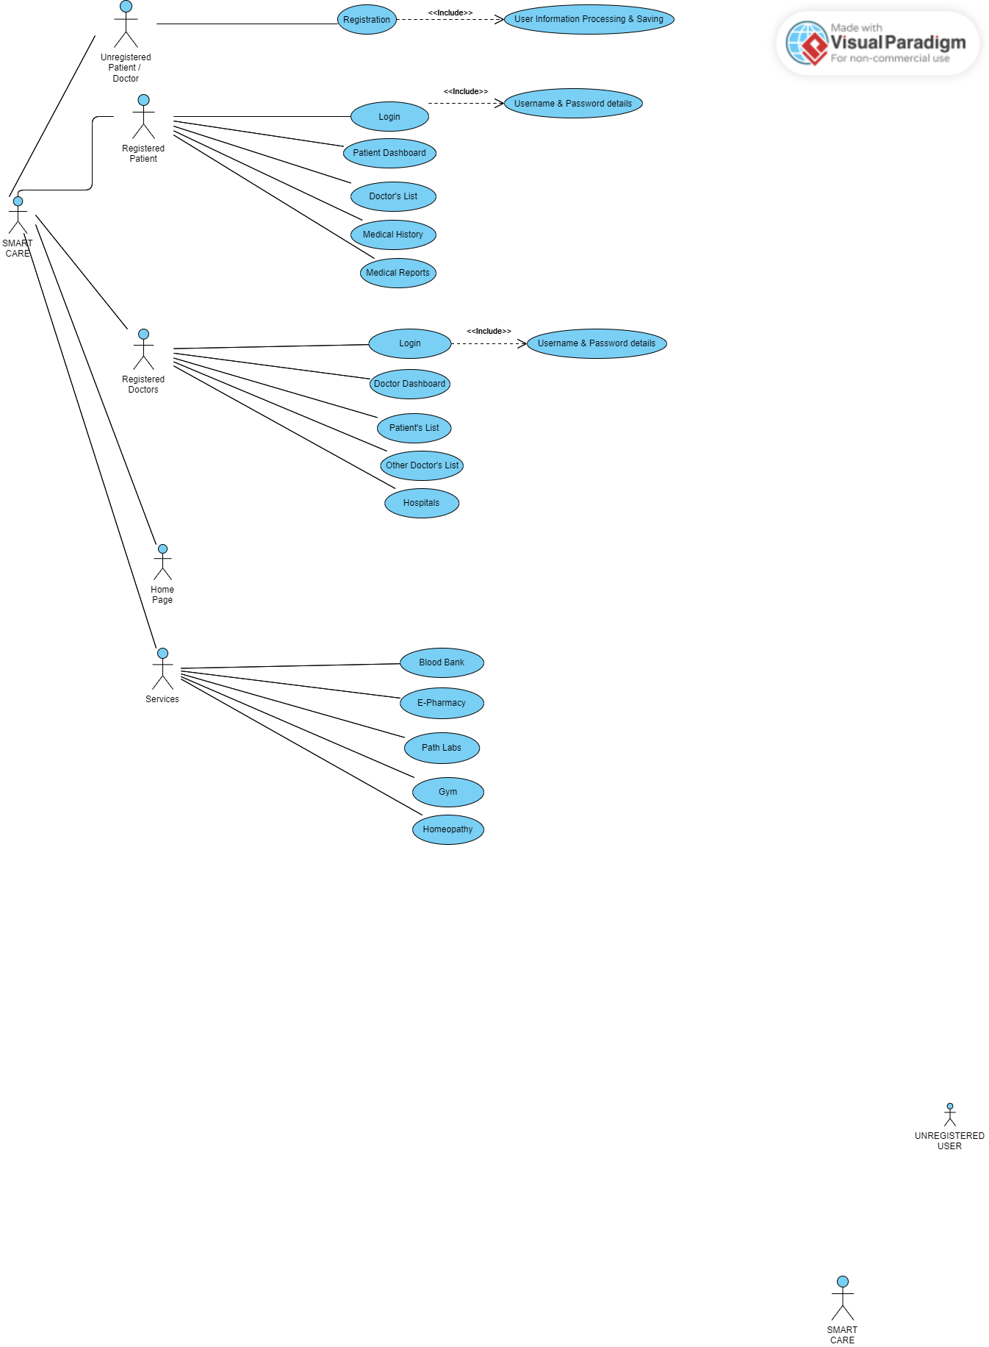
Use Case Diagram
Continue in page 2

Slide 14
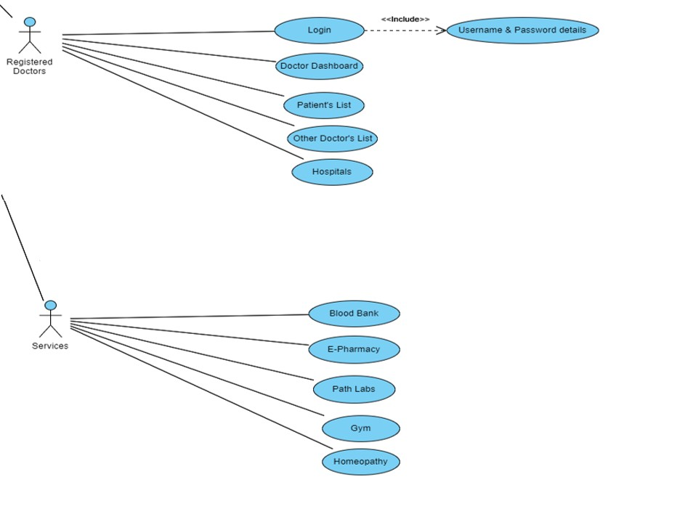
Use Case Diagram
Continue…

Slide 15
ER Diagram

Slide 16
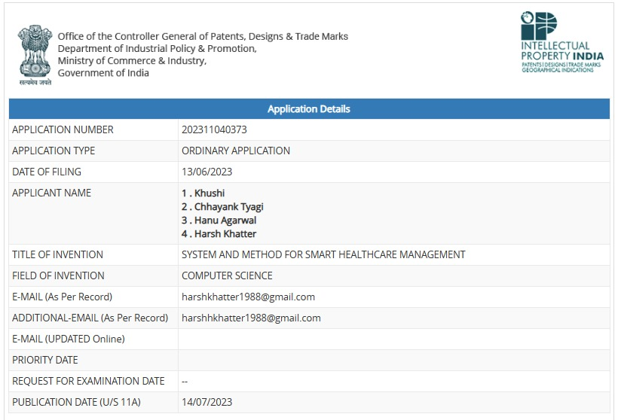
Patent Status
Patent Application Number
Published on 14 July 2023

Slide 17
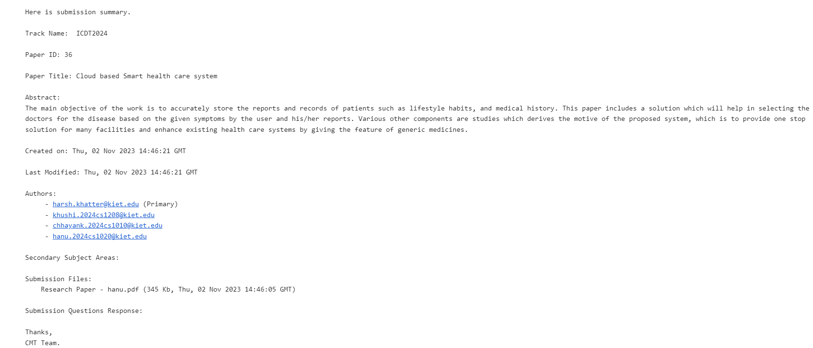
Research Paper Status

Slide 18
References
[1] Morris ME, Adair B, Miller K, Ozanne E, Hansen R, et al, “SmartHome Technologies to Assist Older People to Live Well at Home.,” Journal of Aging Science 1:101, 2013.
[2] ] L. Klack, C. Möllering, M. Ziefle, T. Schmitz-Rode, “Future Care Floor: A sensitive floor for movement monitoring and fall detection in home environments,” In Wireless Mobile Communication and Healthcare (pp. 211-218). Springer Berlin Heidelberg, 2011.
[3] Faiyaz Doctor, Hani Hagras, and Victor Callaghan, “A fuzzy embedded agent-based approach for realizing ambient intelligence in intelligent inhabited environments,” IEEE Transactions on Systems, Man and Cybernetics, Part A: Systems and Humans, 35(1):55–65, January 2005.

